Slide 1

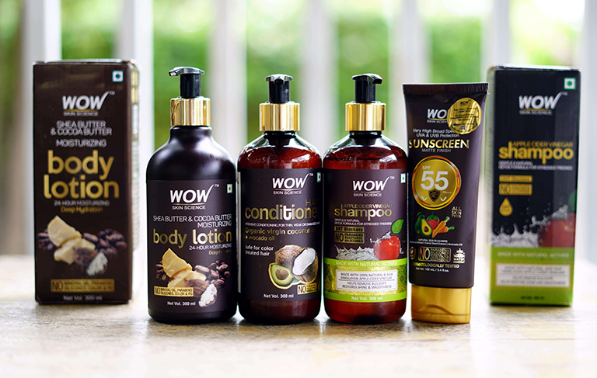
WOW COSMETICS
UNIVERSITY NAME:
Dry B R Ambedkar University
GC FOR WOMEN SRIKAKULAM
Group Members :
Team Leader 1: MUKALLA ROJA
Team member 2: CHAMARTI LAKSHMI
Team member 3: GORLE LAVANYA
Team member 4:LINGUDI MADHAVI

Slide 2
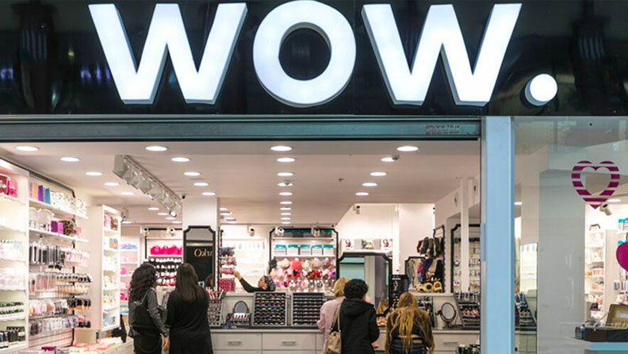
Part 1: Brand study, Competitor Analysis and Buyer’s/Audience’s Persona
Research Brand:
Mission/Values:
USP:
Analyze Brand Tone and Identity:
Set 4 SMART Goals and KPIs for
the same :

Slide 3
Brand Study (Mission /Values & USP)
Mission & Values:
WOW created a brand exclusivity with its “nature-based scientific formulation” narrative besides its focus on quality and competitive pricing.
There are so many popular products from Wow Cosmetics!
Some of the favorites among beauty enthusiasts are their
Wow Brow
Eyebrow pencil
Glow Getter
Highlighter palette
Lash Boss
Mascara.
These products are total game-changers and
give you that wow factor!
💁‍♀✨

Slide 4
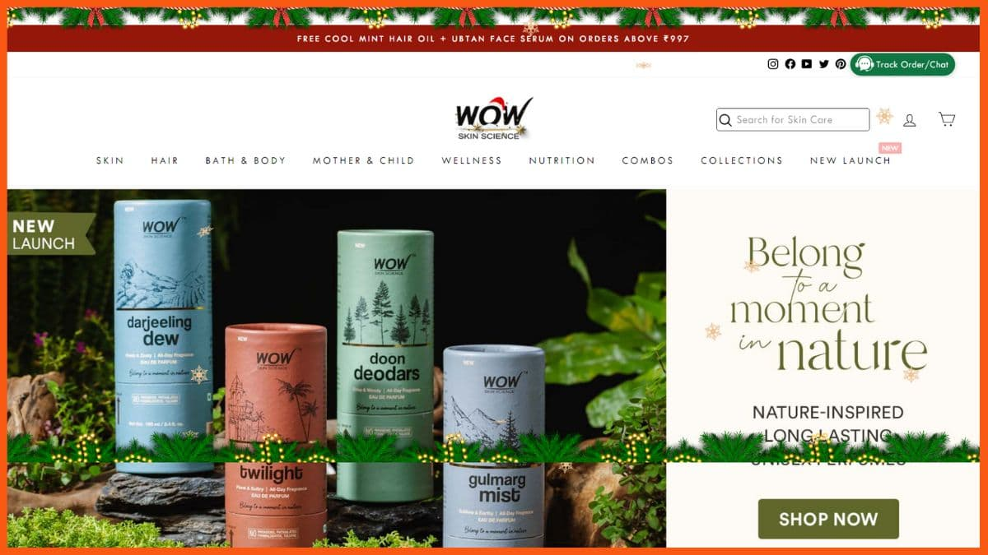
Digital demand alone has boosted the sales of WOW products by over $1 Million a month. Presently the brand has signed two Bollywood actresses — Disha Patani for their haircare range and Bhumi Pednekar for their skincare range — as their brand ambassadors. This is coupled with its social media influencers tie-ups.
Fortune is in the failure. When WOW Skin Science hit an estimated valuation of $3.7 Billion, the world changed for these friends-turned-co-founders – Aravind Sokke, Ashwin Sokke, Karan Chowdhary and Manish Chowdhary, who rose from the ashes in 2016 with their venture’s inception.

Slide 5
Brand study (brand tone & KPI)
Brand Tone : Wow Cosmetics has an amazing brand tone! It’s all about being bold , glamorous, and confident. They want you to feel like a superstar when you use their products.💄✨
Simple Skincare’s KPIs may Include:
Sales growth : Dude, the sales growth for Wow Cosmetics has been incredible! They’ve been blowing up in the beauty industry. People are loving their products and the brand is really taking off. 🚀 💥
Customer Satisfaction :Bro, customer satisfaction with Wow Cosmetics is through the roof! People are raving about the quality of their products, the stunning results, and the awesome customer service. They really know how to make their customers happy.👍😊
Brand Awareness: Dude, brand awareness for Wow Cosmetics is off the charts! They've been making waves in the beauty community and gaining a ton of recognition. It seems like everyone is talking about their awesome products and killer makeup looks. 🌟🔥
Market share: Wow Cosmetics has been gaining some serious market share! They've been making a big impact in the beauty industry and capturing the attention of makeup lovers everywhere. Their unique products and strong brand presence have helped them carve out a significant piece of the market. It's pretty impressive, man! 🙌💪

Slide 6
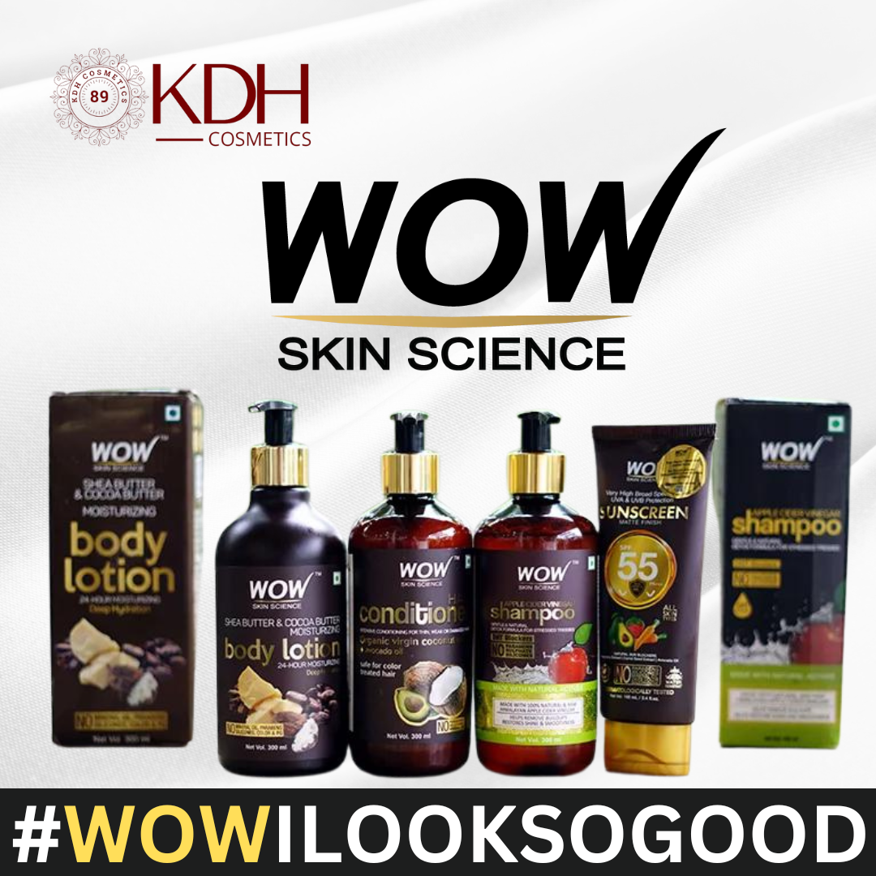
Buyer/Audience persona
Name: Wow Cosmetics
Demographics
Age: 18-60
Gender: All genders
Occupation: Homemakers and working professionals
Income: Middle to High Income Individuals
Psychographics :
Values: Clean, Natural, and effective skincare products.
Interests: Skincare, self –care, and personal grooming
Personality: Conscious, informed, and health-conscious
individuals who prioritize their skin health and appearance

Slide 7
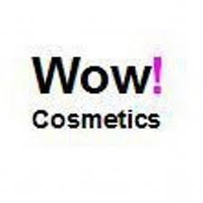
Behavior
Shopping habits: When it comes to shopping, Wow Cosmetics has got you covered! They have an awesome online store where you can browse and purchase their products with just a few clicks. They also have physical stores in major cities where you can go in-person and have a hands-on shopping experience. And don't forget about their collaborations and limited edition releases that get makeup enthusiasts hyped up! So whether you prefer online shopping or hitting up a store, Wow Cosmetics makes it easy to get your glam on. Happy shopping, dude! 🛍💄✨ Social media usage: Wow Cosmetics is all about slaying it on social media! They're super active on platforms like Instagram, TikTok, and YouTube, where they share makeup tutorials, product launches, and behind-the-scenes sneak peeks. They also engage with their followers, hosting giveaways, and featuring user-generated content. So if you want to stay in the loop and get some major makeup inspo, make sure to follow Wow Cosmetics on their social media accounts. It's a great way to connect with other makeup enthusiasts too! 📸💄

Slide 8

GOALS and CHALLEGES:
GOALS
The goals of Wow Cosmetics are all about empowering individuals to feel confident and express themselves through makeup. They strive to create innovative and high-quality products that cater to a diverse range of beauty needs. They also aim to foster a positive and inclusive community where everyone feels welcome and inspired. Ultimately, Wow Cosmetics wants to help people embrace their unique beauty and have fun with their makeup journey. It's all about spreading good vibes and glam, my friend! 🌟💄✨
CHALLENGES
Every company faces its fair share of challenges, and Wow Cosmetics is no exception. One of the challenges they might face is staying ahead of the ever-changing beauty industry trends. They have to constantly innovate and come up with new and exciting products to keep up with the demands of their customers. Another challenge could be maintaining a strong online presence and engaging with their audience across various social media platforms. And of course, there's always competition in the cosmetics industry, so Wow Cosmetics has to work hard to stand out and offer something unique. But hey, challenges just make them stronger.. 💪💄✨

Slide 9
competitor analysis
Competitor analysis:
Competitor 1:
Bioderma
Competitor 2:
GoodVibes
Competitor 3:
My Wishcare

Slide 10
Competitor 1: Bioderma
USP:
When it comes to the unique selling points (USPs) of Wow Cosmetics compared to Bioderma India, here are a few things to consider:
1. Natural and Organic: Wow Cosmetics prides itself on using natural and organic ingredients in their products. This can be a major USP for those who prefer clean and eco-friendly beauty options.
2. Cruelty-Free: Wow Cosmetics is committed to being cruelty-free, meaning their products are not tested on animals. This can be a significant selling point for those who prioritize ethical beauty choices.
3. Innovative Formulations: Wow Cosmetics is known for its innovative formulations that target specific skin concerns. They may have unique ingredients or technologies that set them apart in the market.
4. Affordable Luxury: Wow Cosmetics aims to provide high-quality products at affordable prices, making luxury beauty accessible to a wider audience.
5. Wide Range of Products: Wow Cosmetics offers a diverse range of beauty products, including skincare, makeup, haircare, and more. This variety allows customers to find multiple products that suit their needs.Remember, these are just a few potential USPs. Wow Cosmetics may have other exciting features that make them stand out from Bioderma India. 😊💄

Slide 11
Online communication:
SWOT
Strengths: Natural and Organic ingredients appeal to customers who prioritize clean beauty.
*Cruelty-free practices resonate with consumers who value ethical beauty choices.
*Innovative formulations may attract customers looking for unique and effective products.
*Affordable pricing makes luxury beauty accessible to a wider audience.
*Wide range of products allows customers to find multiple options to meet their needs.
Weakness: Limited brand recognition compared to well-established brands like Bioderma India. *May have a smaller distribution network and availability in certain regions
Opportunities: Growing demand for natural and organic beauty products presents an opportunity for Wow Cosmetics to capture a larger market share. *Collaborations with influencers or beauty experts can help increase brand visibility and reach a wider audience. *Expanding distribution channels, both online and offline, can help reach more customers
Threats: Intense competition in the beauty industry from established brands like Bioderma India and other emerging players. *Changing consumer preferences and trends may impact the demand for certain product categories.

Slide 12
Competitor 2: Good vibes
USP:
Good Vibes brand! Their unique selling proposition could be all about spreading positivity and uplifting vibes through their products. Whether it's clothing, accessories, or even inspirational content, their brand focuses on promoting a positive and optimistic lifestyle. It's all about radiating good vibes and encouraging others to do the same! 🌟😊
Online Communication:
SWOT:
Strengths:- Strong brand image centered around positivity and good vibes.- Wide range of products that cater to different preferences and styles.- Engaged and loyal customer base who resonate with the brand's message.- Effective use of social media platforms to connect with their audience.
Weaknesses:- Potential competition from other brands with similar messaging.- Limited geographical reach or distribution channels.- Possible difficulty in maintaining consistent messaging across different product lines.

Slide 13

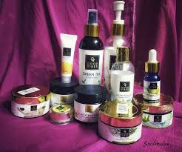
Opportunities:- Expansion into new markets or collaborations with influencers to reach a larger audience.- Launching new product lines or expanding into related lifestyle categories.- Leveraging user-generated content and customer testimonials to strengthen brand credibility.
Threats:- Changing consumer trends or preferences that may affect the demand for positivity-focused brands.- Potential negative feedback or backlash on social media platforms.- Economic factors that could impact consumer spending habits.Overall, the Good Vibes brand has a strong foundation and a unique positioning in the market. By capitalizing on their strengths and exploring new opportunities, they can continue to thrive and spread positive vibes to more people! 🌈✨

Slide 14
Competitor 3:My Wishcare
USP:
My Wishcare brand is all about personalized self-care. We believe that everyone's self-care journey is unique, so we provide customized products and services tailored to individual needs. Whether it's skincare, wellness, or relaxation, My Wishcare offers a personalized approach to help you feel your best and take care of yourself in a way that suits you perfectly. It's all about making self-care a truly personal and enjoyable experience! 🌸✨
Online communication
SWOT
Strengths:- Personalized approach to self-care, catering to individual needs and preferences.- High-quality products and services that are tailored to provide effective results.- Strong emphasis on customer satisfaction and building long-term relationships.- Innovative and unique offerings that set My Wishcare apart from competitors.
Weaknesses:- Limited brand awareness and reach, especially in competitive markets.- Potential challenges in scaling personalized services to a larger customer base.- Dependence on customer data and preferences, which requires robust data management systems.

Slide 15
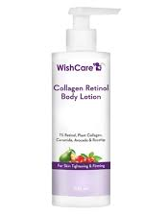
Opportunities:- Expansion into new markets and target demographics to increase brand visibility.- Collaboration with influencers and partnering with wellness professionals for endorsements.- Introduction of new personalized self-care categories or services to diversify offerings.
Threats:- Intense competition from established self-care brands and emerging startups.- Changing consumer preferences and trends in the self-care industry.- Potential negative reviews or feedback that could impact brand reputation.
By leveraging its strengths, seizing opportunities, and addressing weaknesses and threats, My Wishcare can continue to grow and provide exceptional personalized self-care experiences to its customers! 🌿💖

Slide 16
Part 2: SEO & Keyword Research
SEO Audit
Keyword Research
On Page Optimization

Slide 17
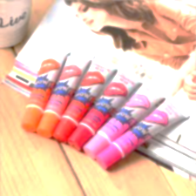
SEO audit
SEO for Wow Cosmetics, they can start by doing some keyword research. They should identify the keywords and phrases that their target audience is searching for, like "best cosmetics," "natural makeup," or "affordable beauty products." Then, they can optimize their website and content by including these keywords in their page titles, headings, and throughout their website copy.
Another important aspect of SEO is creating high-quality and engaging content. Wow Cosmetics can consider starting a blog where they share makeup tutorials, beauty tips, or product reviews. This will not only attract more visitors to their website but also help establish them as an authority in the cosmetics industry.
Additionally, Wow Cosmetics should pay attention to their meta tags and descriptions. These are the snippets of text that appear on search engine results pages. By writing compelling and relevant meta tags and descriptions, they can entice users to click on their website.Lastly, building backlinks from reputable websites is crucial for SEO. Wow Cosmetics can collaborate with beauty influencers or reach out to relevant blogs and websites for guest posting opportunities.
This will help increase their website's authority and visibility in search engine rankings. Hope these tips help Wow Cosmetics boost their online presence and attract more customers! 🌟💄

Slide 18
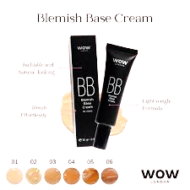
Keyword Research
keyword research for Wow Cosmetics, they should focus on finding the right words and phrases that their target audience is using to search for cosmetics online. They can start by brainstorming some general keywords related to their products, such as "makeup," "beauty," "cosmetics," and "skincare.
Then, they can use keyword research tools like Google Keyword Planner, SEMrush, or Moz's Keyword Explorer to get more specific and relevant keyword ideas. These tools can provide insights on search volume, competition, and related keywords.
For example, they can try searching for keywords like "best makeup products," "organic cosmetics," "long-lasting lipstick," or "affordable beauty brands." These keywords can help Wow Cosmetics understand what people are searching for and optimize their website and content accordingly.
Remember, it's important to choose keywords that are relevant to Wow Cosmetics' products and have a good balance of search volume and competition. This will help them attract the right audience and improve their chances of ranking higher in search engine results..😊🔍💄

Slide 19
On page Optimization
On-page optimization for Wow Cosmetics involves optimizing their website's individual pages to improve their visibility and ranking on search engines. Here are a few key areas they can focus on:
1. Title tags: Wow Cosmetics should ensure that each page has a unique and descriptive title tag that includes relevant keywords. This helps search engines understand the content of the page.
2. Meta descriptions: They should also write compelling meta descriptions for each page. These short snippets appear in search engine results and can influence click-through rates. Including relevant keywords and a call-to-action can entice users to click on their website.
3.URL structure: Wow Cosmetics should aim for clean and descriptive URLs that include relevant keywords. This helps search engines and users understand what the page is about.
4.Heading tags: Proper use of heading tags (H1, H2, etc.) helps organize the content and signals to search engines the importance of different sections. Wow Cosmetics can include relevant keywords in their headings to optimize for search engines.
5. Content optimization: Wow Cosmetics should focus on creating high-quality, unique, and informative content for each page. They can include relevant keywords naturally throughout the content, but should avoid keyword stuffing.
6. Image optimization: They should optimize their images by using descriptive file names and alt tags. This helps search engines understand the content of the images and can improve visibility in image search results.
Remember, the goal of on-page optimization is to provide a great user experience and make it easier for search engines to understand and rank Wow Cosmetics' website.😊🚀

Slide 20
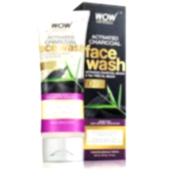
On page Optimization(Content Optimization)
Introduction: Wow Cosmetics is a popular beauty brand known for its high-quality and innovative products. To enhance its online presence and attract more customers, on-page optimization plays a crucial role. By optimizing the content on Wow Cosmetics' website, they can improve search engine rankings, increase organic traffic, and engage visitors effectively.
Content Optimization: Content optimization involves optimizing the text, images, and other elements on a website to make it more appealing to both users and search engines. For Wow Cosmetics, they can start by conducting thorough keyword research to identify relevant and high-ranking keywords related to their products. Incorporating these keywords naturally into product descriptions, blog posts, and other content can help improve search engine..
Conclusion: In conclusion, on-page optimization and content optimization are essential for Wow Cosmetics to enhance their online presence and attract more customers. By conducting keyword research, incorporating relevant keywords, and creating engaging content, they can improve their search engine rankings, increase organic traffic, and ultimately drive more conversions. With a well-optimized website, Wow Cosmetics can continue to wow their customers with their exceptional beauty products! 💄✨

Slide 21
Content calendar [April 2024]
Week 1: -
April 1st: “Spring Beauty Must-Haves" blog post featuring Wow Cosmetics' top products for the season.
April 3rd: Instagram post showcasing a step-by-step tutorial using Wow Cosmetics' new eyeshadow palette.
April 5th: Facebook Live session with a makeup artist demonstrating a full makeup look using Wow Cosmetics' products.
Week 2:-
April 9th: "Skincare Secrets Revealed" video featuring Wow Cosmetics' skincare line and tips for healthy skin.
April 11th: Twitter poll asking followers to vote for their favorite Wow Cosmetics lipstick shade.-
April 13th: Instagram Stories takeover by a beauty influencer showcasing their favorite Wow Cosmetics products.
Week 3:-
April 16th: "Get the Glow: Highlighter Hacks" blog post sharing tips and tricks for using Wow Cosmetics' highlighters.-
April 18th: Instagram post featuring before and after photos of customers using Wow Cosmetics' foundation.-
April 20th: Facebook contest inviting followers to share their best makeup looks using Wow Cosmetics with a chance to win a prize.
Week 4:-
April 23rd: "Spring Cleaning Your Makeup Bag" video featuring Wow Cosmetics' tips for organizing and refreshing your makeup collection.- April 25th: Twitter chat with Wow Cosmetics' experts answering customer questions about skincare routines.-
April 27th: Instagram giveaway announcing a collaboration with a popular fashion brand, where followers can win a Wow Cosmetics gift set.
Remember, this content calendar is just a starting point. Feel free to customize it based on Wow Cosmetics' goals, promotions, and any special events happening in April

Slide 22
Part 3: Content Ideas and Market Strategies
Wow Cosmetics can explore various content ideas and marketing strategies to engage their audience and promote their products. Here are a few ideas to get started:
1. Tutorial Videos: Wow Cosmetics can create tutorial videos showcasing different makeup looks and how to use their products. They can share tips, tricks, and step-by-step guides to help their audience achieve desired makeup looks.
2. Product Reviews: They can collaborate with beauty influencers or their own customers to create honest and informative product reviews. Sharing real-life experiences and showcasing the benefits of their cosmetics can build trust and credibility.
3. Before-and-After Transformations: Wow Cosmetics can share before-and-after photos or videos featuring their products. This visual demonstration can highlight the effectiveness of their cosmetics and attract potential customers.
4. Beauty Tips and Advice: They can create blog posts or social media content that provides beauty tips, skincare routines, and makeup hacks. Sharing valuable information can position Wow Cosmetics as an authority in the beauty industry.
5. User-Generated Content: Encouraging their customers to share their makeup looks using Wow Cosmetics' products can generate a lot of user-generated content. They can feature this content on their social media platforms to showcase the versatility and quality of their cosmetics.
6. Influencer Partnerships: Collaborating with popular beauty influencers who align with Wow Cosmetics' brand values can help reach a wider audience. Influencers can create content featuring Wow Cosmetics' products and share their experiences with their followers.
7. Social Media Contests and Giveaways: Wow Cosmetics can run contests and giveaways on their social media platforms to increase engagement and attract new customers. They can ask participants to share their favorite makeup looks or tag friends to enter the contest.
Consistency and engaging with their audience are key in implementing these content ideas and marketing strategies. By creating valuable and shareable content. Wow Cosmetics can build brand awareness and loyalty.

Slide 23
Content creation and curation
content creation and curation ideas for Wow Cosmetics! Here are a few suggestions:
1. Product Showcase: Create visually appealing content that highlights the features and benefits of Wow Cosmetics' products. This can include high-quality images, close-up shots, and swatches to give potential customers a better idea of what to expect.
2. Makeup Looks: Curate and create makeup looks using Wow Cosmetics' products. This can range from natural everyday looks to bold and glamorous styles. Include step-by-step instructions and product recommendations to make it easy for your audience to recreate the looks.
3. Skincare Tips: Share skincare tips and routines that complement the use of Wow Cosmetics' products. This can include information on different skin types, common skincare concerns, and how to achieve a healthy and radiant complexion.
4. Trend Spotting: Keep up with the latest beauty trends and share your take on them using Wow Cosmetics' products. This can include popular makeup techniques, color schemes, or even seasonal trends like holiday-inspired looks
.5. Behind-the-Scenes: Take your audience behind the scenes of Wow Cosmetics' photo shoots or product development process. This can give them a glimpse into the brand's creative process and build a sense of connection and authenticity
6. Customer Testimonials: Share testimonials and reviews from satisfied customers who have used Wow Cosmetics' products. This can help build trust and credibility among your audience and encourage them to try the products themselves.
7. Expert Advice: Collaborate with makeup artists, beauty bloggers, or skincare experts to provide expert advice and tips. This can include interviews, Q&A sessions, or even guest blog posts that offer valuable insights and recommendations..
curate and create content that resonates with your target audience. Stay consistent, engage with your followers, and encourage them to share their experiences with Wow Cosmetics' products. 💄📸✨

Slide 24
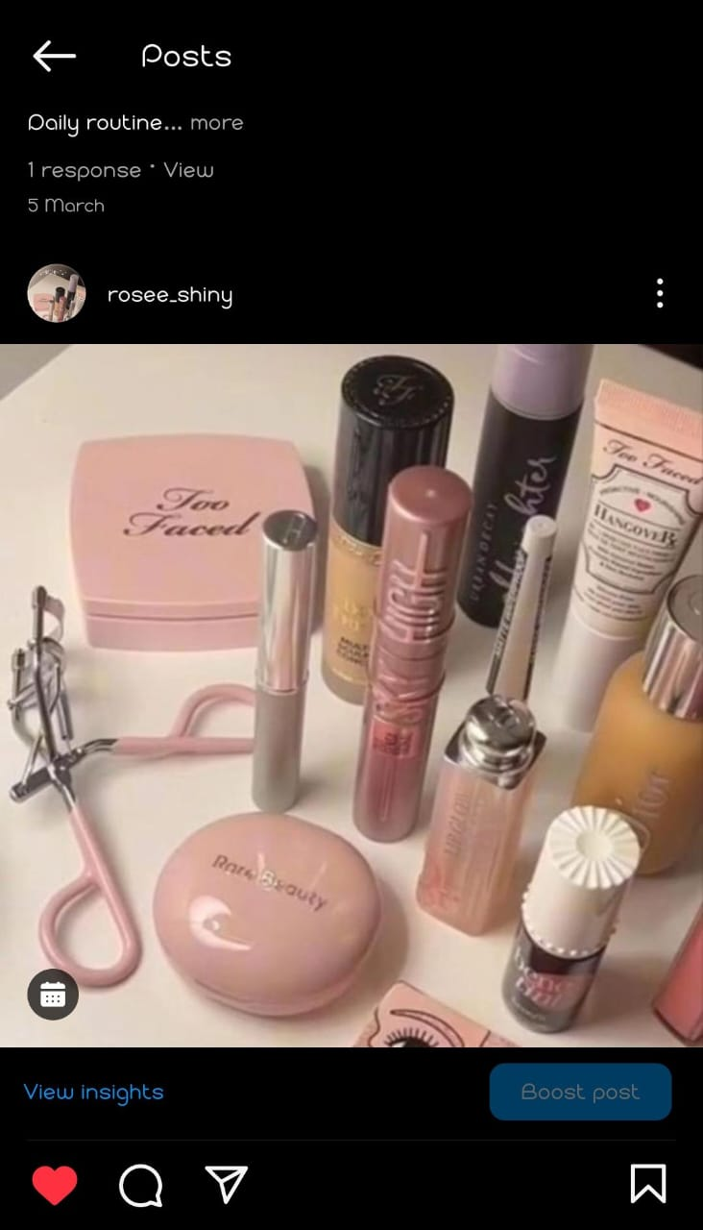
Format 1:Post Creation
Link:
https://www.instagram.com/p/C4FkxEfLt-_/?igsh=b2FpMXdobTBhOXNw
Caption:
Slaying the makeup game, one swipe at a time.
Good Makeup, Good Mood
Hashtags:
#makeup #wowcosmetics #lipstick #skincare #cleanser #cometics
#eyebrows #lipgloss #beauty #instamakeup #haircare #makeupoftheday
#wakeupandmakeup

Slide 25
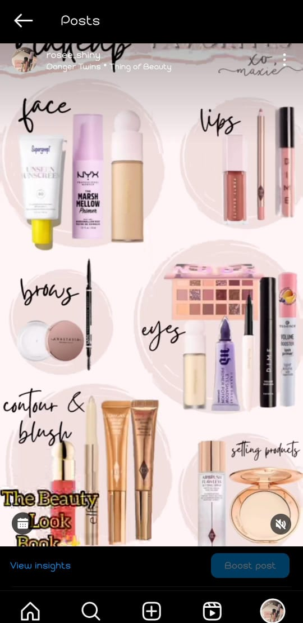
Format 2: Reel post
Link:
https://www.instagram.com/reel/C4H2yJpLZVs/?igsh=MjlydGNnYWs5bTN1
Caption:
Beauty
Makeup
Daily routine makeup
Function Makeup
Bridal Makeup
Hashtags:
#makeup #makeuplook #makeuppowder #makeuptutorial
#lipint #lipstick #lipgloss #nailart #nailpolish
#blush #eyemakeup #eyebrows

Slide 26
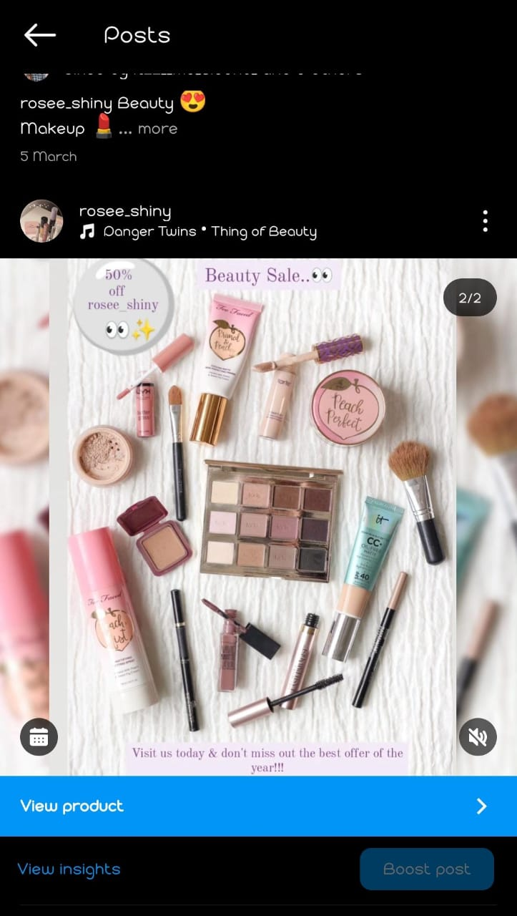
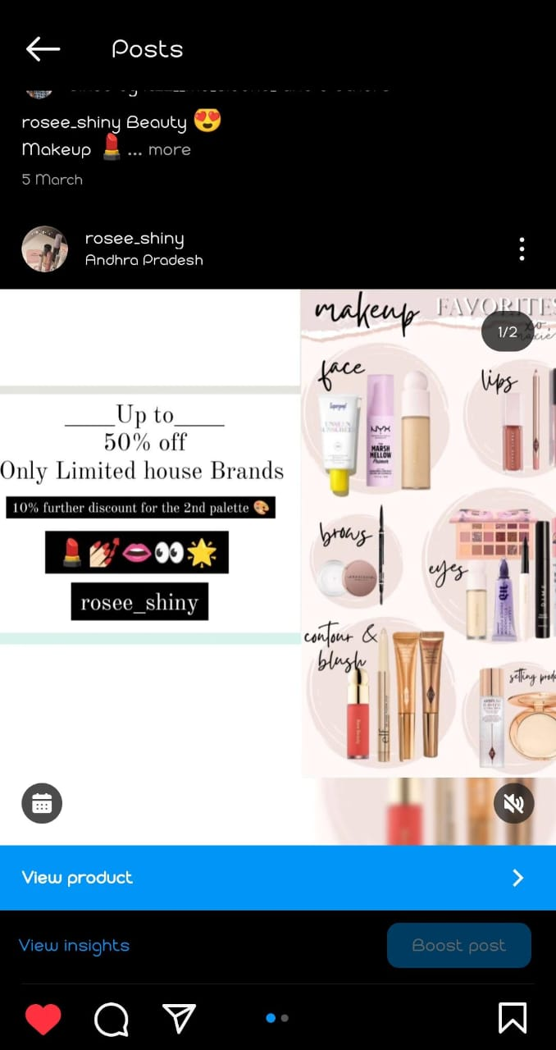
Format 3: Carousel post
Link:
https://www.instagram.com/p/C4H2gD1LIys/?igsh=MTMydXM2N3puMTl1Zg==
Caption:
Daily Routine
Glamour Makeup
@rosee_shiny
Hashtags:
#makeupartist #makeuplook #makeup
#makeuptutorial #cosmetics #lipgloss
#lipstick #facemakeup #blush
#makeuppowder #nailart

Slide 27
Instagram Story
Instagram Story Links:
https://www.instagram.com/s/aGlnaGxpZ2h0OjE4MDE2NjI2OTkyMjM2NzYz?story_media_id=3346081223063328009_64692915651&igsh=dGZraDdvYmx0dno4
https://www.instagram.com/s/aGlnaGxpZ2h0OjE4MDE2NjI2OTkyMjM2NzYz?story_media_id=3346083323411303979_64692915651&igsh=dGZraDdvYmx0dno4
Instagram Highlights Links:
https://www.instagram.com/s/aGlnaGxpZ2h0OjE3ODgxMjEzOTg2MDMwMDg1?story_media_id=3317493531449027633_64692915651&igsh=bW8yb29uOGhnNHVn
https://www.instagram.com/s/aGlnaGxpZ2h0OjE3ODgxMjEzOTg2MDMwMDg1?story_media_id=3324742798645313989_64692915651&igsh=bW8yb29uOGhnNHVn

Slide 28
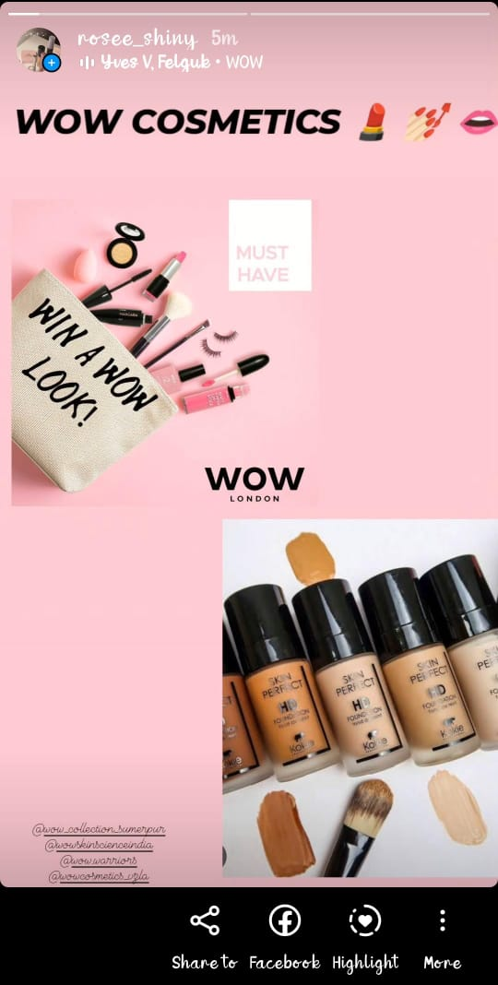
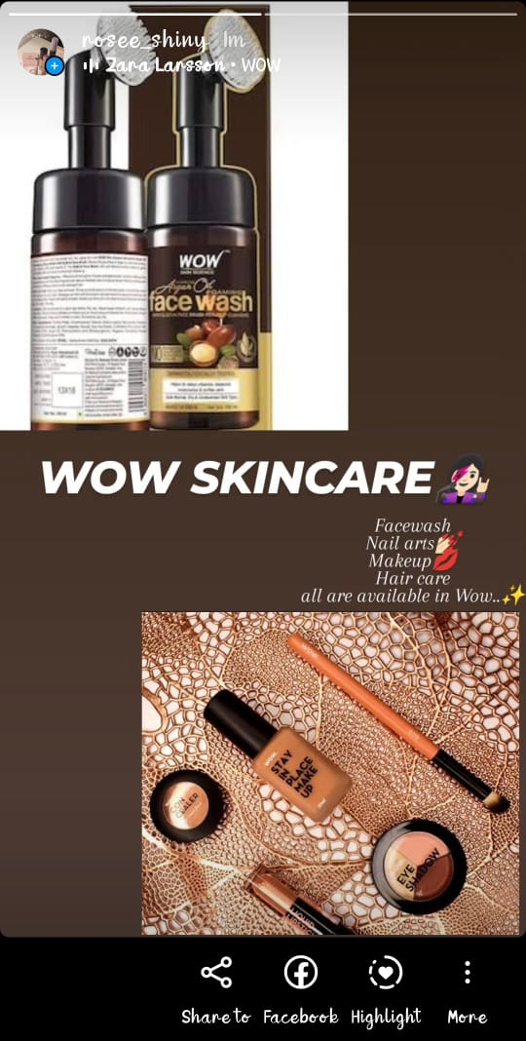
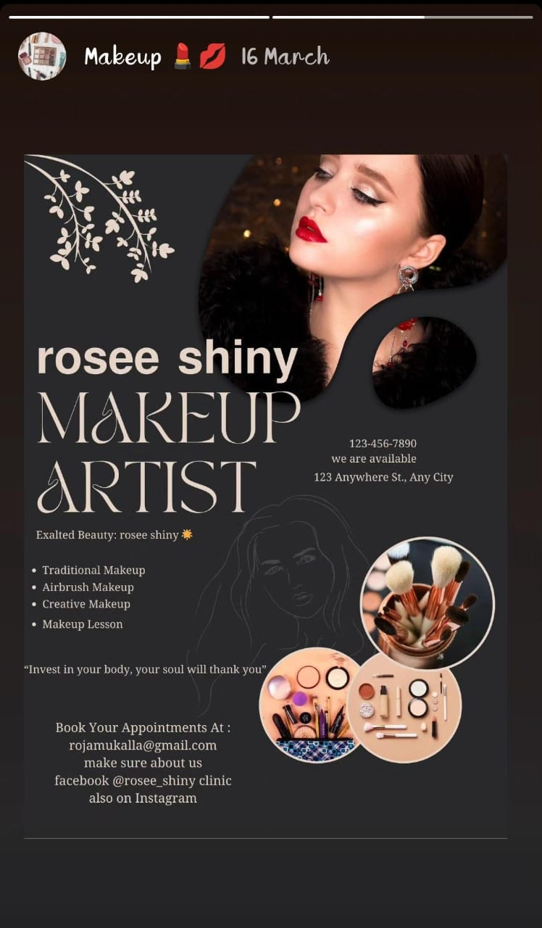
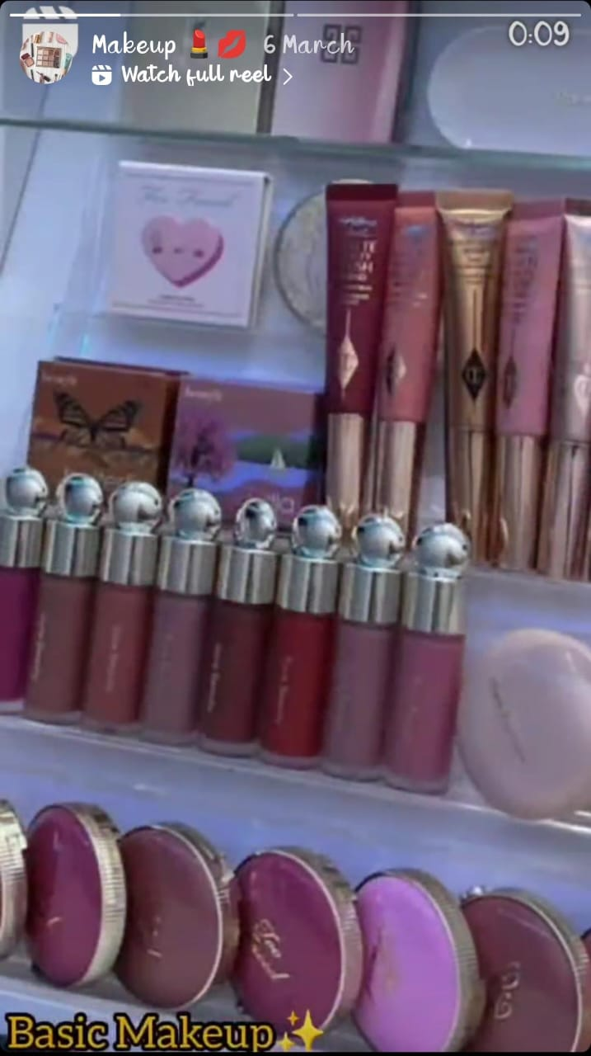
Screenshots of Story:

Slide 29
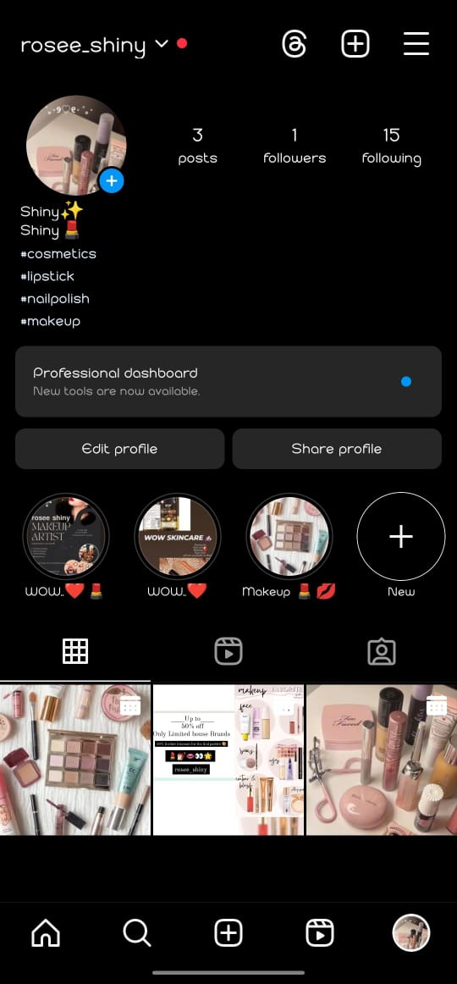
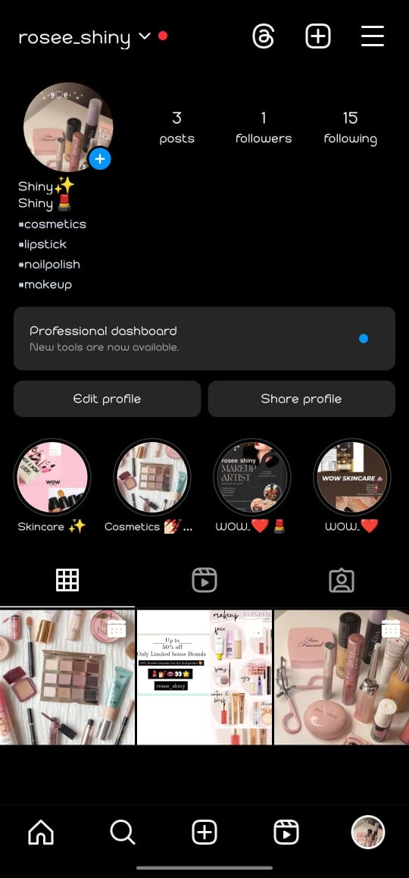
Highlights for Story:

Slide 30
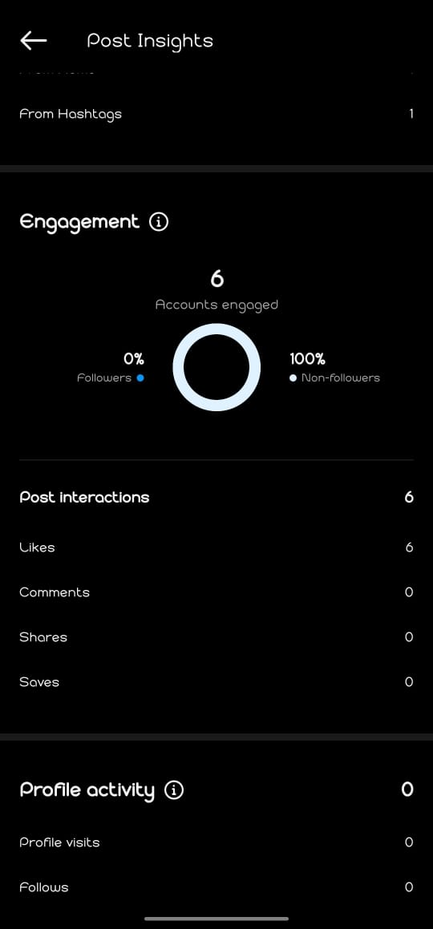
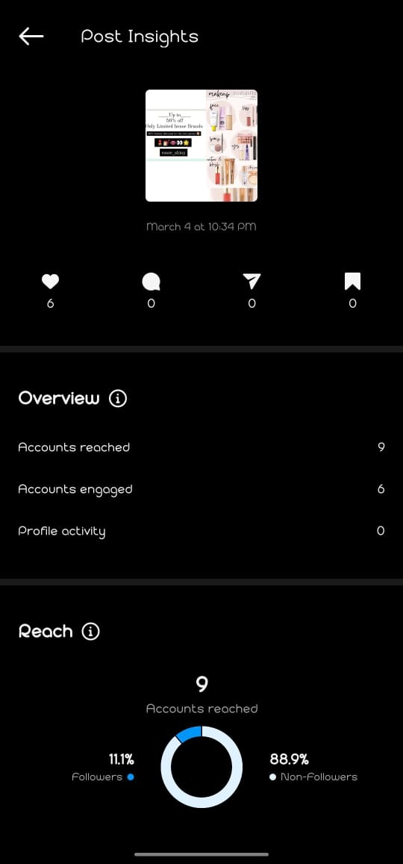
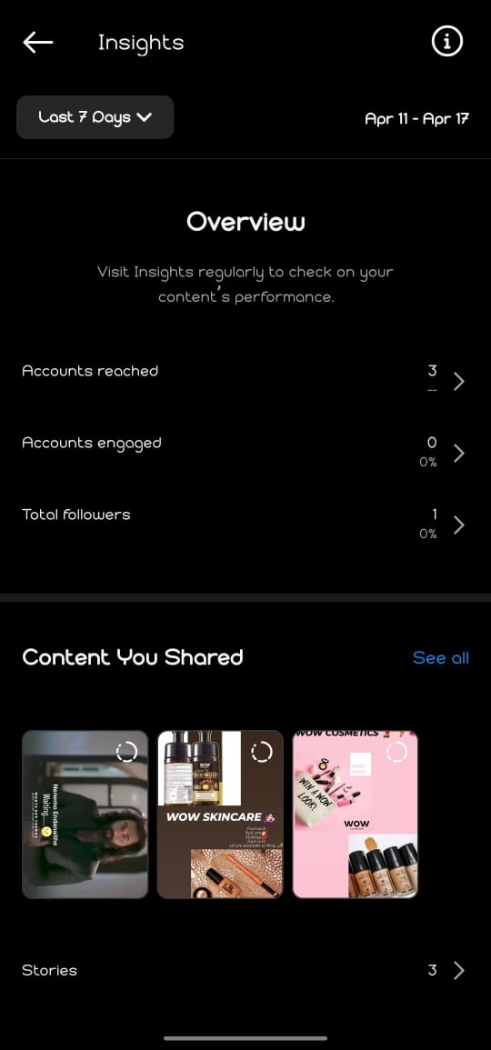
Story Insights-Q&A

Slide 31
THANK YOU

